Slide 1
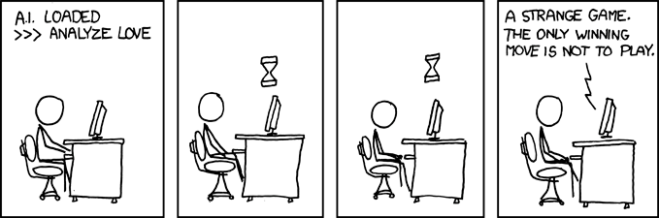
In Search of Value Equilibria
xkcd.com
By Christopher Kleven & Dustin Richwine

Slide 2


Group
Mentor:
Dr. Michael L. Littman
  Chair of the Computer Science Dept.
  Specializing in AI and Reinforcement Learning
Grad Student Mentor: Michael Wunder
  PhD Student studying with Dr. Littman

Slide 3
Game Theory
Study of interactions of rational utility-maximizing agents and prediction of their behavior
    An action profile is a Nash Equilibrium of a game if every player’s action is a best response to the other players actions. (Described in an article in 1951 by John Nash)
Normal Form Game |  | Column
 |  | A | B
Row | A | a, b | c, d
 | B | e, f | g, h

Slide 4
Example
Spoiled Child and
Prisoners’ Dilemma
Analysis
 |  | Child
 |  | Behave | Misbehave
Parent | Spoil | 1, 2 | 0, 3
 | Punish | 0, 1 | 2, 0
Parent’s Action in Mixed Equilibrium:
  (1/2)Spoil & (1/2)Punish→1.5
Child’s Action in Mixed Equilibrium:
    (2/3)Behave & (1/3) Misbehave→.667
Prisoners’ Equilibrium: Each Defects
 |  | Your Accomplice
 |  | C | D
You | C | 3, 3 | 0, 4
 | D | 4, 0 | 1,1

Slide 5
Reinforcement Learning
Def: Sub area of machine learning concerned with how an agent ought to take actions so as to maximize some notion of long term reward
  Come in two types
    Policy Search- seeks optimal distribution over actions
    Value Based- seeks most profitable action
  Michael Wunder, Michael Littman, and Monica Babes Classes of Multiagent Q-learning Dynamics with epsilon-greedy Exploration

Slide 6
Q-Learning
Initialize
  For each action A, give a value to Q(A)
Update
  Q(action) ←(1 – α)Q(action) + αR
Explore
  For some small ε, on each move, play a random strategy with probability ε

Slide 7
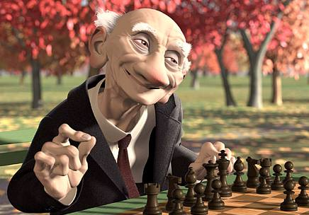
Value Equilibria
In self-play, Q-learning is known
to converge to the optimal strategy in Markov Decision Processes. (Tsitsiklis)
In self-play, the IGA algorithm, yields payoffs for each player which converge to the value of a Nash Equilibrium. (Singh)
In self-play, IQL-ε may display chaotic non-converging behavior in certain general-sum games with a non-pareto Nash Equilibrium. (Wunder)

Slide 8
Goals
Develop improved Reinforcement Learning Algorithms for learning to play effectively
Generalize the results of the ε-greedy paper on numbers of players, states and available actions.
Formalize the notion of value equilibrium and compare it to the Nash
Determine the similarity of a successful learning algorithm's behavior to an organism’s behavior.

Slide 9
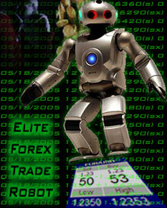
Importance
    “It is widely expected that in the near future, software agents will act on behalf of humans in many electronic marketplaces based on auction, barter, and other forms of trading.”
    –Satinder Singh
    Learning the state that results from interactions of AI can lead us to predict the long-term value of these interactions
    A successful algorithm may prove conducive to the understanding of the brain’s ability to learn

